Slide 1
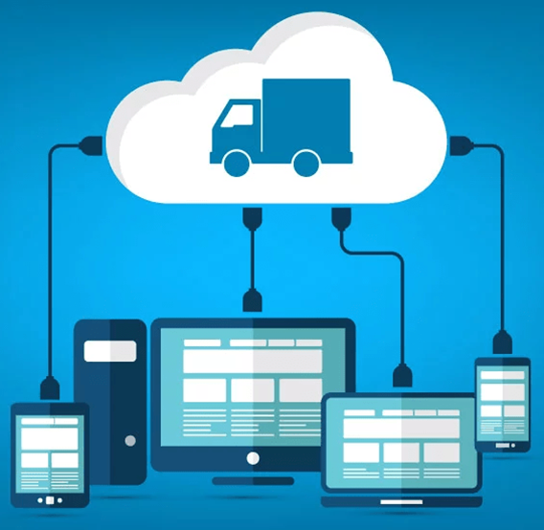
CLOUD COMPUTING ROLE IN LOGISTICS
GROUP 4
Anis Aqharie (Information Systems, UTP)
Nur Syazwani binti Azahar (Chem Eng, UTP)
Mardhiah binti Maarof (Business Management, UNISEL)
Luqman Anwar (Actuarial Science, USIM)
Arvend Rajan ( IT, UTP)

Slide 2
CLOUD SERVICES MODEL
Computer enabled service practices often change due to the enhancement of information and communication technologies, just like fashion changes over a time in consumer industries.
Computing is being transformed to a model consisting of commoditized services, through a “cloud” from which users can access applications anywhere in the world on demand.

Slide 3
3 TYPES OF SERVICES
Software as a Service (SaaS)
It focuses on providing users to run existing on-demand online applications accessed over the Internet. For example, warehouse management systems, and transportation management systems are typical applications.
Platform as a Service (Paas)
It allows users to create their own applications using supplier-speciﬁc tools and languages. Typical examples of this category Are Google App Engine, and Microsoft Windows Azure.
Infrastructure as a Service (IaaS)
It provides users to run any applications of their own choice on cloud hardware (e.g., network, memory, and storage facilities.) Prominent examples of this category are AmazonEC2, GoGrid and Flexiscale.

Slide 4
Why must consider cloud computing technology in logistics industry?
• The threat of new competitors is prominent with information technology, making it easier to enter the market.
• The expectations of modern customers are quite high, and they expect the service to be as quick as possible.
• There is always a need for change in management. The traditional information system is rigid and takes a lot of time and money. Cloud computing technologies make it easier to change the management and operational procedures without spending much time and money.
• The process management is made simpler with cloud computing technologies with fewer visibility barriers and enough real-time data to make the operational decision quickly. It also makes it easier to scale the business with minimal waste of time and less cost.

Slide 5
The advantages of Cloud Computing in Logistics Industry
Real-Time Pricing
Real-Time Inventory
Equipment and Utilization Patterns
Accurate Merge in Transit Model
Office Resources Flexibility

Slide 6
REAL-TIME PRICING
Quickly understanding the price associated with every logistics element of your supply chain allows you to control your costs with finesse.
Pricing elements within transportation and warehousing can fluctuate based on any number of factors, such as weather, market conditions or demand.
With so much volatility on the fly adjustments can make or break margins.

Slide 7
REAL-TIME INVENTORY
The inventory you have on hand is your most direct means of controlling for risks and optimizing costs.
Real-time inventory management allows you to maximize your ability to respond to demand fluctuations while holding onto your buffer against emergencies.
Data flow from the cloud gives you infinitely more precise control over your inventory levels.

Slide 8
EQUIPMENT AND UTILIZATION PATTERNS
Within any repetitive system, pattern recognition is essential to optimization.
Cloud-integration allows metrics to be taken and analysed in a myriad of ways to expedite making those patterns apparent within shipping and procurement.
From how equipment is utilized to the most frequent freight movement, cloud-based software systems help discover patterns and utilize them to better capitalize on abundance or eliminate wasteful excess.

Slide 9
ACCURATE MERGE IN TRANSIT MODEL
When trying to coordinate the union of a number of components from several suppliers, possibly from all over the world, synchronizing processes is paramount to efficiency.
Within certain situations, having processes synchronized down to the hour might be required.
Logistics solutions that allow for real-time monitoring through the cloud makes accurate models of merge in transit possible for the first time.

Slide 10
OFFICE RESOURCES FLEXIBILITY
Cloud-integrated logistics not only provided more data in real-time, it makes it accessible to your entire team, regardless of location or time.
Universal accessibility makes processes that require round the clock oversight far more easily handled.
Logistics managers can observe processes in real-time from remote locations and allows immediate resource deployment in case response is needed.

Slide 11

THANK YOU

